Slide 1
Building and provisioning genomics platforms on the world’s clouds
Enis Afgan
Johns Hopkins University
Galaxy Project
April 2016, University of Heidelberg

Slide 2
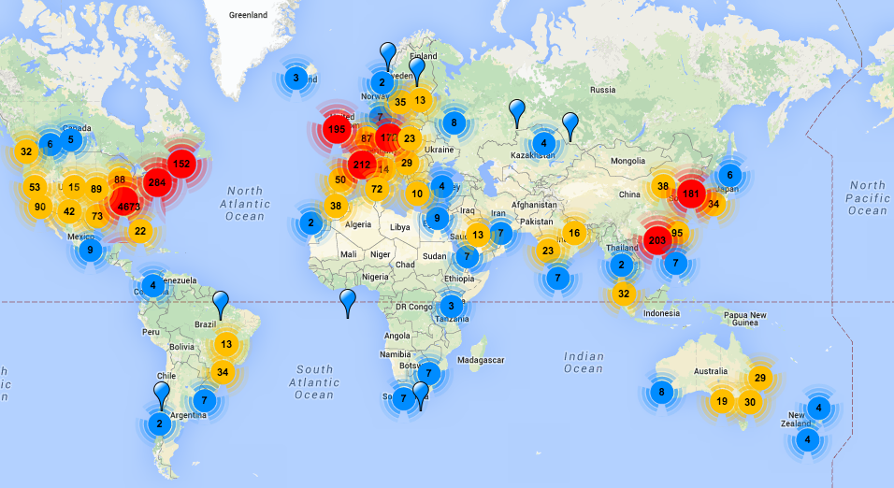
We’ve all seen this map
omicsmaps.com

Slide 3

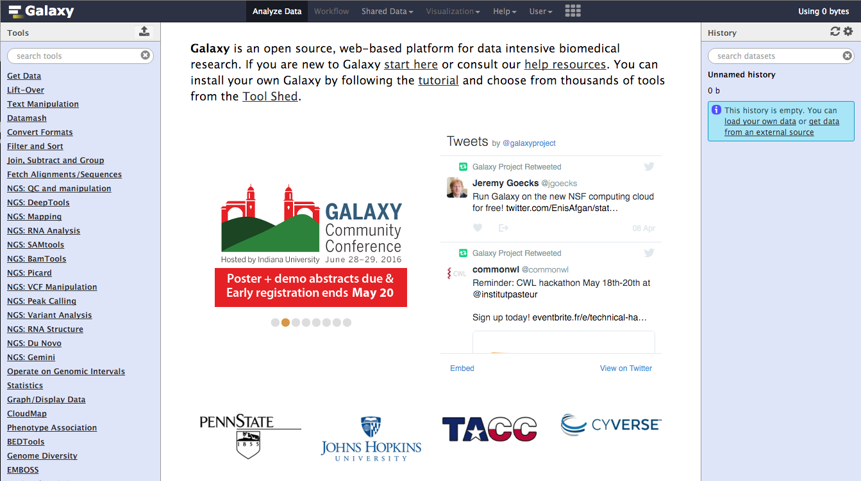
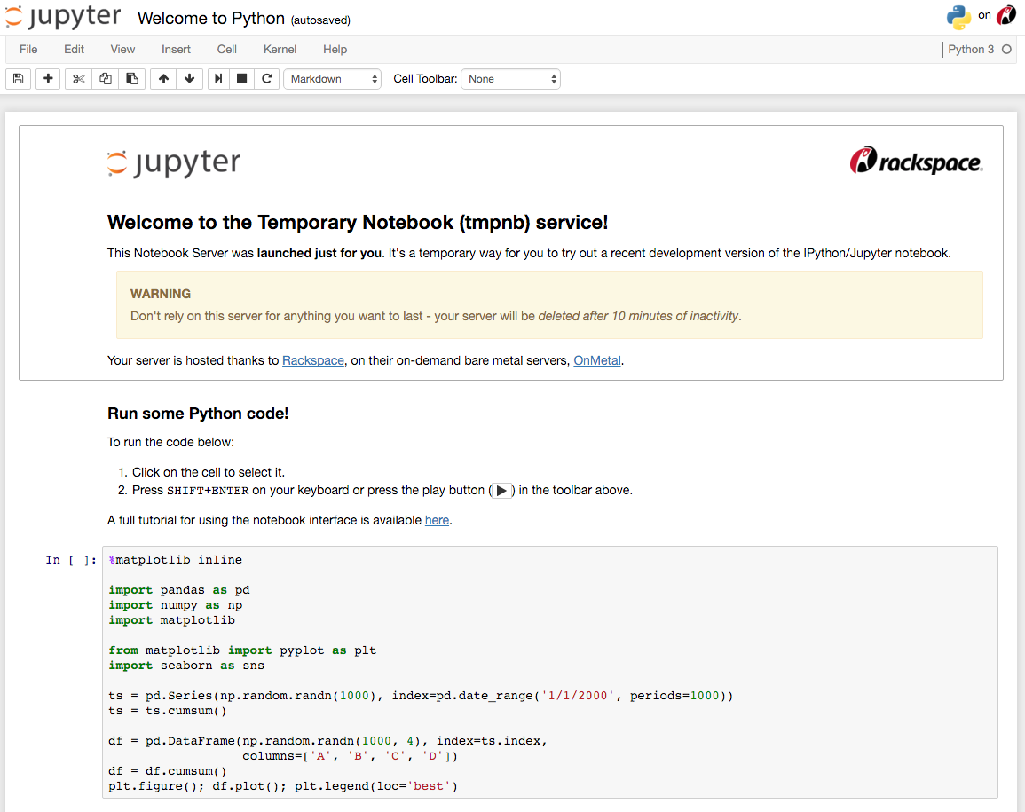
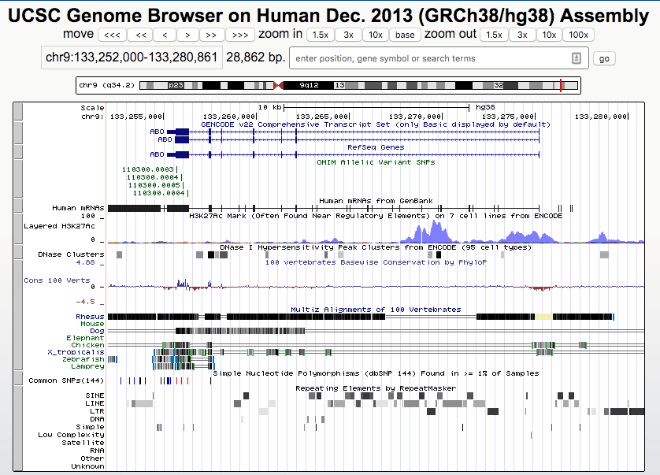
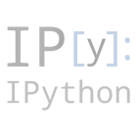
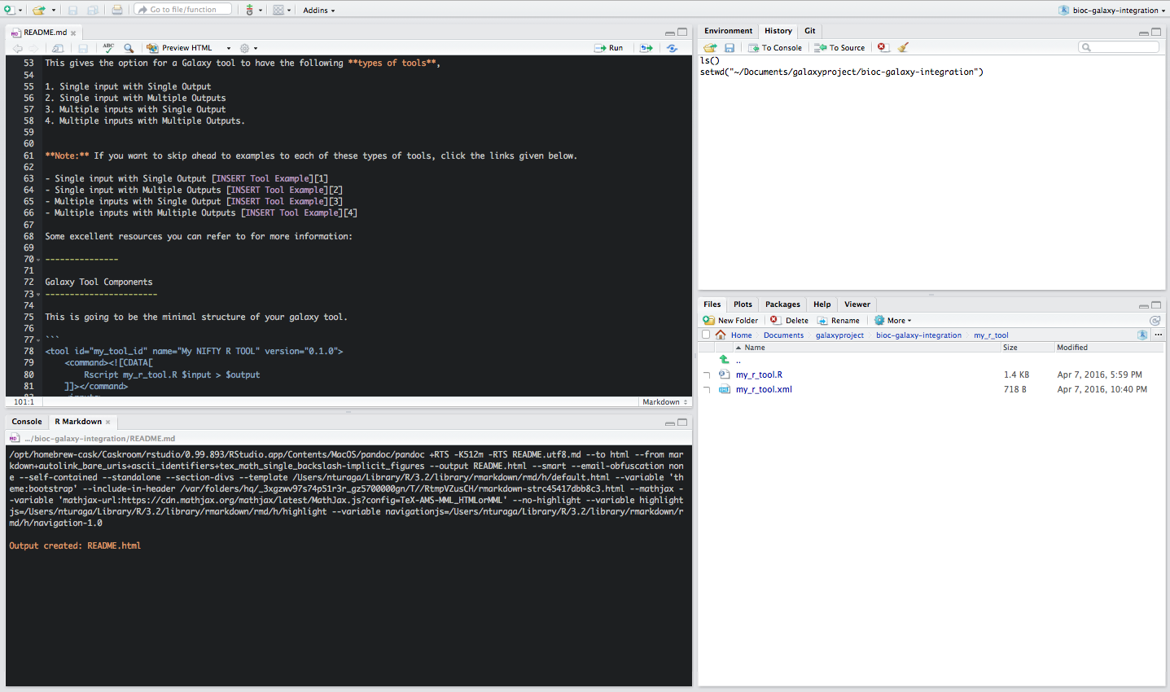


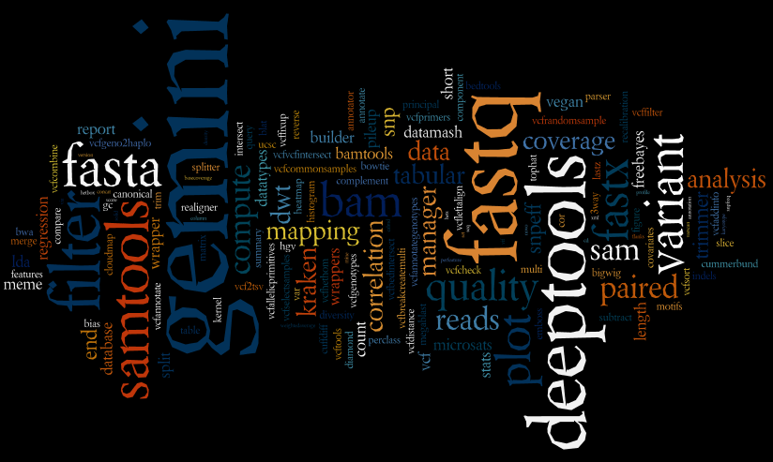
Data analysis solutions exist

Slide 4
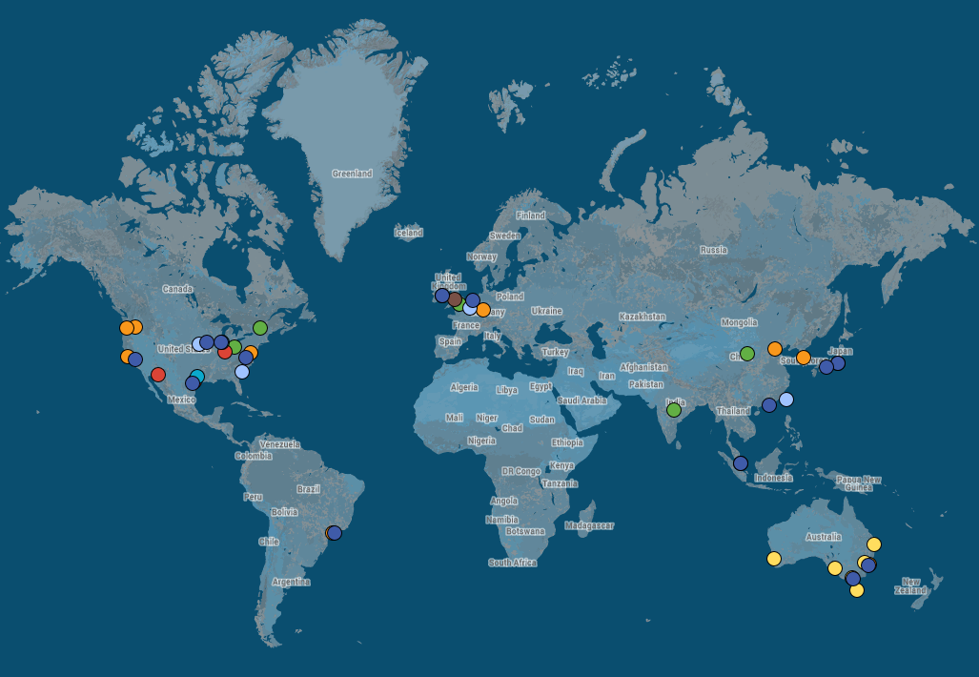
World’s clouds
AWS
AWS (coming soon)
Azure
Chameleon
Google Compute Engine
Jetstream
NeCTAR

Slide 5
Capacity without end-to-end solution

Slide 6

How to appropriately utilize clouds?
VM
Platform
Service

Slide 7
Standalone VM
Pre-configured server that is readily available.
Pros
Easy to build; easy to deploy
Low cloud infrastructure requirements ⟶ Transferable
Cons
Limited capacity (compute and storage)
See it in action
wiki.galaxyproject.org/Cloud/Jetstream

Slide 8

Scalable platform
Set up a virtual cluster across multiple VMs with app services.
Pros
Dynamically scale compute and storage
Higher-level services: persistent storage, sharing, multi-application
Cons
Complicated build; considerable infrastructure requirements
See it in action
wiki.galaxyproject.org/CloudMan

Slide 9
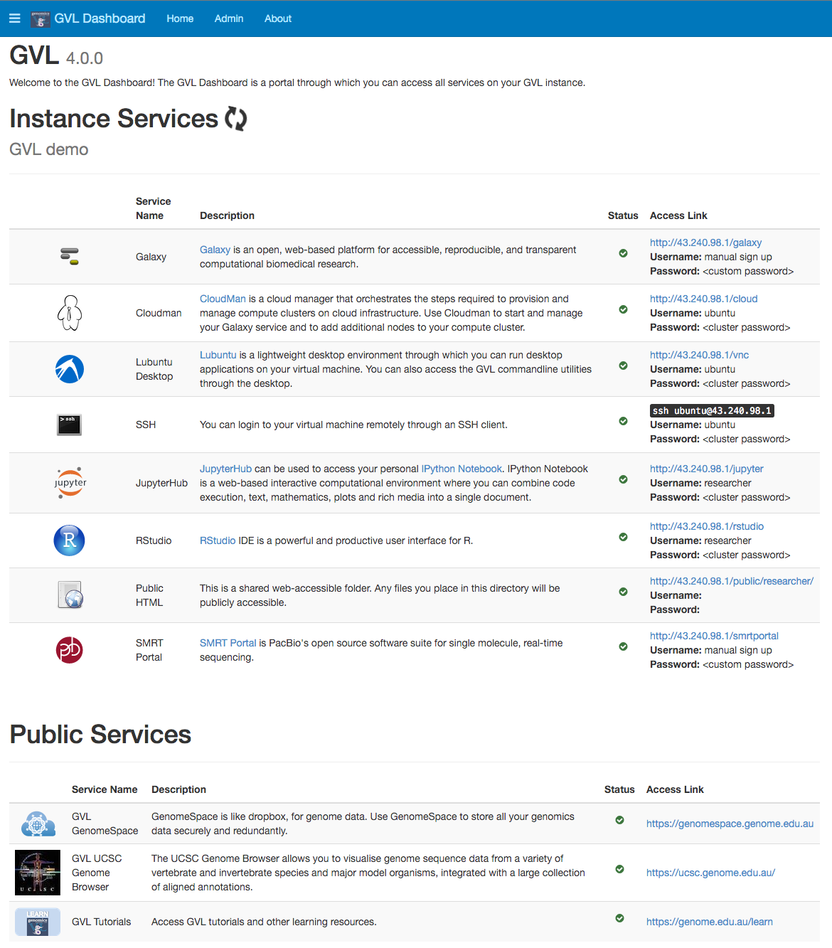
Scalable platform (cont)
Data analysis spans more than one application (even if that is Galaxy).
Meet Genomics Virtual Lab (GVL)
Pros
Versatile platform built on the scalable CloudMan cluster
Includes common tutorials
Cons
Demanding to build
Calls for more customization
See it in action
genome.edu.au

Slide 10
Ready-to-use service
Use cloud resources from an always-on, public service
Pros
Visit a URL and start computing – no setup required
Cons
User quotas still apply
It’s still a public service: no user customization
See it in action
usegalaxy.org (bwa, bowtie2 – more coming)

Slide 11
There’s a lot of clouds out there!
AWS
AWS (coming soon)
Azure
Chameleon
Google Compute Engine
Jetstream
NeCTAR

Slide 12

How to appropriately utilize many clouds?
VM
Platform
Service
Build system

Slide 13
Adjustable build system
Automate the process of building each component
Codify knowledge about the system ⟶ easier to reproduce
We use Ansible as the technology of choice
Compose systems from configurable and reusable roles
Galaxy-Kickstarter
Playbook
Galaxy-CloudMan
Playbook
Use-Galaxy
Playbook
artbio.github.io/ansible-artimed/
github.com/galaxyproject/
galaxy-cloudman-playbook
github.com/galaxyproject/
usegalaxy-playbook

Slide 14





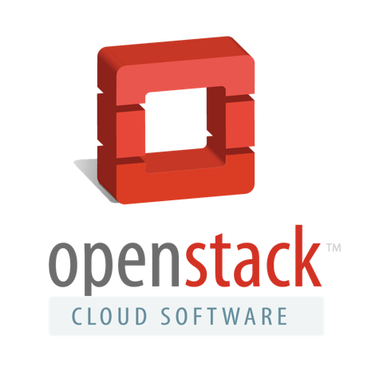

Many clouds AND many solutions
!?!
launch.genome.edu.au ; use.jetstream-cloud.org ; launch.usegalaxy.org

Slide 15
CloudBridge (future)
A Simple Cross-Cloud Python Library
Offer a uniform API irrespective of the underlying provider
Provide a set of conformance tests for all supported clouds
Focus on mature clouds with a required minimal set of features
Be as thin as possible
Support for AWS and OpenStack exists; Google Cloud under development
cloudbridge.readthedocs.org

Slide 16

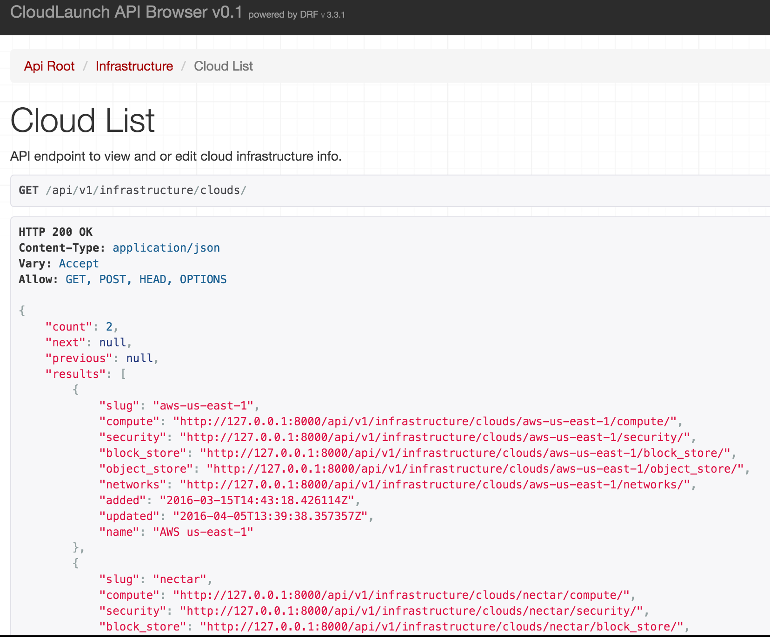
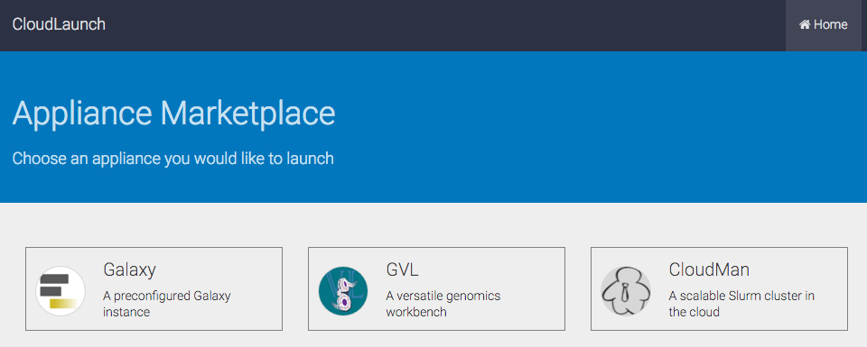
CloudLaunch (future)
A centralized launcher for any app and any cloud.
User configurable applications and clouds; view and launch shared instances; multi-cloud dashboard view
github.com/galaxyproject/cloudlaunch
github.com/galaxyproject/cloudlaunch-ui

Slide 17
CloudMan (future)
Resource manager with configurable service layer
Pull away from low-level application service management
Leverage containers to supply services
Allow runtime service and configuration changes
Run on any infrastructure, including high-level services, such as ECS, or Docker API
Goal: Launch a (template-based) CloudMan platform and add application services as desired from Dockerhub or similar while resource provisioning is automatically handled.

Slide 18
Galaxy ObjectStore (future)
Allow uniform any-Galaxy computing (i.e., make Galaxy instances interchangeable and disposable)
Galaxy implements an ObjectStore interface as an abstraction to data
Leverage it to expand user data storage and allow any Galaxy to connect to a user’s bucket
Use ObjectStore for reference data (simplify builds)
Still will need to deal with the database dependency

Slide 19
The endgame?
ObjectStore
launch.usegalaxy.org
A
P
P
L
I
C
A
T
I
O
N
S
CloudMan
CloudBridge

Slide 20
Building your own cloud?
Make it easy For end-users to register and get onboard (very simple auth) For deployers to interface with the cloud (adopt ‘standards’)
Develop capacity and usage plans Go for monthly-reset, merit-based Allocation Units (AUs)
Design for flexibility Users need more storage? Different instance types?
Create champion teams Bring them onboard early to deploy target apps; give them $$$
Start with good documentation Technical but not overly detailed (look at AWS) Be open; add great, interactive support
Design a training program For application developers and end users; build a community
Notes:
Standards: expose API, reliable/adopted middleware,

Slide 21





Acknowledgments

Slide 22


Want more Galaxy?
gcc2016.iu.edu

Slide 23



usegalaxy.org cloud-bursting
job_conf.xml
NFS
usegalaxy.org
CVMFS

